Slide 1

Domestic violence

Slide 2
Defining it (Anova 2024)
Domestic violence is abuse, control, and/or violence that occurs in the context of a family or partnership.
It can happen between intimate partners, between siblings, between parents and children, and/or between adult children and elderly parents.
The use of abusive behaviours and/or violence is a choice.

Slide 3
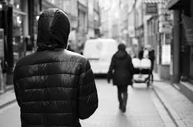
A few examples
Physical assaults
Stalking
Harassment
Sexual exploitation
Controlling a partner’s finances
Humiliation and verbal abuse
Intimidation and threats

Slide 4
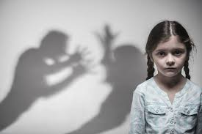
Other terms for DV
Intimate partner violence
Family violence
Gender based violence

Slide 5
Canada: Key facts (Juristat 2021)
One in four victims of police-reported violence victimized by a family member
Family violence in 2019 increased for the third year in a row, with larger increase among men and boys
Family-related sexual violence more than five times higher for women and girls than men and boys
Saskatchewan and Manitoba have highest rates of family violence among the provinces

Slide 6
6 common myths/misconceptions
Domestic violence does not affect many people.
Domestic violence is just an occasional slap or punch that is not serious.
Drinking or drug abuse causes domestic violence.
If the abuser is truly sorry and promises to reform, the abuse will stop.
The victim can always walk away from the relationship.
Victims have the types of personalities that seek out and encourage abuse.

Slide 7
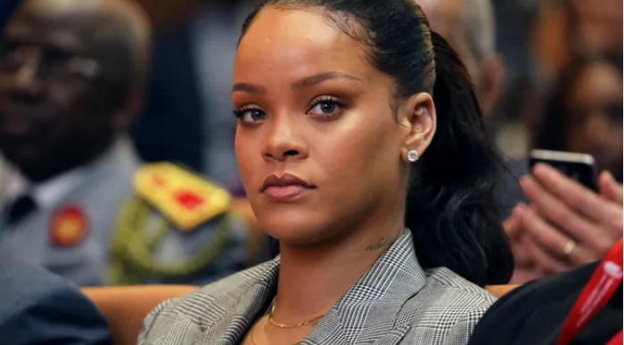
Victims’ experiences

Slide 8
Leah: “Picture perfect life” (Huey and Broll 2017)
From the outside, Leah lived what appeared to be the picture-perfect life with a successful husband and beautiful home. “We had this image,” she said, “that we were this perfect entity.”
The reality was very different: “There were times when we were travelling around the world and times when he would put a knife to my throat. After the second and third time, I realized he wasn’t bullshitting. He really was gonna kill me.” Leah fled to a domestic violence shelter, because, she said, “I didn’t want to be a statistic.”

Slide 9
Tiffany: Afraid to leave (Huey and Broll 2017)
When she was barely out of adolescence, Tiffany began a relationship with a forty-eight-year-old man. “We used to fight all time,” she said. “Do everything but break bones.” During one fight, “he put a butcher knife up to my neck and he had said, ‘I will kill you if you keep on doing something.’ He threatened to kill me a couple of times.”
During another fight, he “literally hit me in the back of the head with a broomstick handle.” Like many women in her situation Tiffany said she “was too afraid to leave the relationship because I didn’t really have any other place to go. So, I just stayed.”

Slide 10
Gillian: Coercive control (Gilette 2023):
“coercive control can refer to any pattern of oppressive, dominating behavior that uses harm to steer one’s thoughts, feelings, and actions.”
“While coercive control is often seen through forms of emotional abuse in intimate partner settings, it can also involve the use of physical force.”

Slide 11
Gillian’s experience of coercive control (Huey and Broll 2018):
Gillian had an extensive history of violent victimization, the beginnings of which she traced to a relationship with her ex-husband, the man she described as scaring her “down to [her] soul.” Gillian’s marriage, which she spoke of as being “a little abusive,” became completely dysfunctional when Gillian was introduced to crack cocaine, which her husband used to control her.

Slide 12
Gillian’s words:
“I don’t know what he was into or what was up, but I knew that there were always baseballs of crack. There are so many things I don’t remember, so many times where I woke up in places that it would scare me. I don’t know if I was blacking out or what I was doing during those times … He abused me something terrible. He hurt me deeply on a physical level, spiritual level, psychological level.”

Slide 13
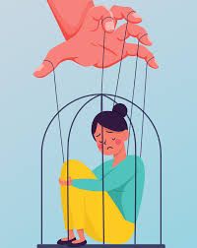
8 signs of coercive control
Assaults
Threats
Humiliation
Isolation
Activity monitoring
Financial control
Sexual coercion
Restricting physical freedom and removing personal choice

Slide 14
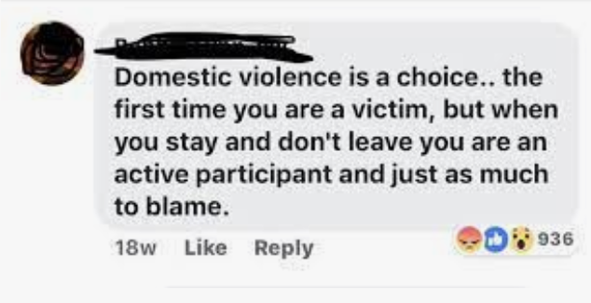
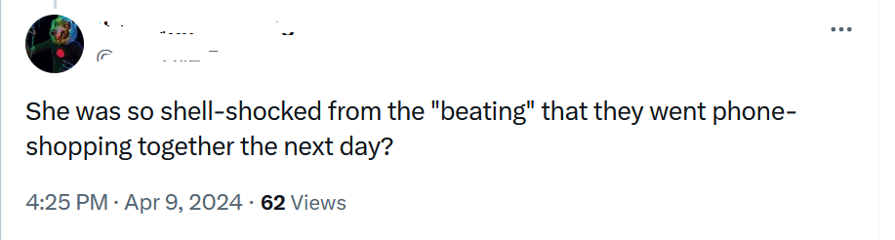
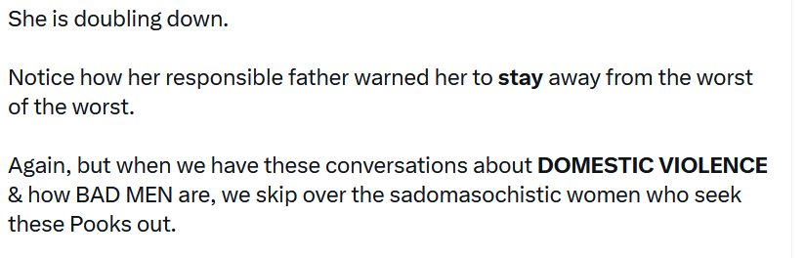
Victim blaming

Slide 15

*all done!*

